Slide 1
AI Assisted Software Development
Requirements → Code

Slide 2
John Michael Miller
Senior Software Engineer at Code Staffing
Played roles of developer, architect, devops engineer, platform engineer, test architect, release manager
AI/ML Enthusiast and advocate for Effectively using AI to write code
LinkedIn: www.linkedin.com/in/johnmichaelmiller
Email: john.miller@codestaffing.com
Blog: https://codemag.com/blog/AIPractitioner

Slide 3
Day Four – Greenfield Development

Slide 4
But first…
Update on running prompts in GitHub Workflows

Slide 5
Agenda
AI Assisted Workflow
Project Requirements
What requirements?
Conceptual Models
Workflows
Project Instructions
Implementation Prompts
Implementation Verification
Executing Implementation Prompts
Lessons Learned
Iteration 3
Tips and Tricks

Slide 6
Exercise #1 – Fork the repos
Objective: Fork the course repos
Search GitHub for
AI-Assisted-Software-Development
zeus.academia.2
zeus.academia.3a
Fork the repos
This will create a personal copy under your GitHub account
You can make changes without affecting the original repo

Slide 7
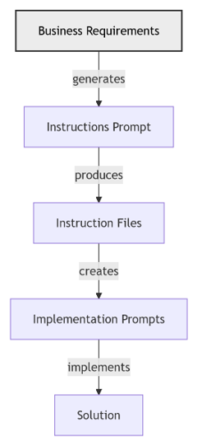
High Level AI Assisted Workflow
- From Requirements to a Solution
- Stakeholders define the requirements
- AI transforms the requirements into implementation instructions
- Stakeholders review and improve instructions
- AI uses instructions to create implementation prompts
- Stakeholders review and improve implementation prompts
- AI uses implementation prompts and implementation instructions to implement the solution
- Stakeholders review and improve implementation

Slide 8
High Level AI Assisted Workflow
From Requirements to a Solution
Stakeholders define the requirements
AI transforms the requirements into implementation instructions
Stakeholders review and improve instructions
AI uses instructions to create implementation prompts
Stakeholders review and improve implementation prompts
AI uses implementation prompts and implementation instructions to implement the solution
Stakeholders review and improve implementation
AIASD Workflow

Slide 9
Starting with Project Requirements
Business rules
Workflows
Tech stack
Architecture
Notes:
Shift to greenfield best practices: requirements, prompts, and verification workflows.

Slide 10
Project Requirements
Key Elements:
Business Rules
Workflows
Tech Stack
Architecture

Slide 11
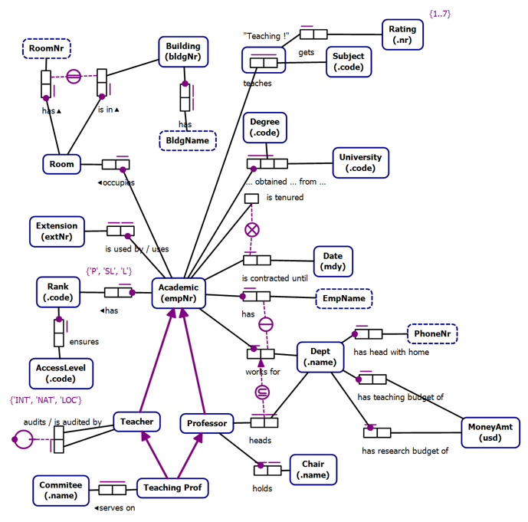
Business Rules as Instructions

Slide 12
Conceptual Models
Technology Agnostic
Transformable into Logical Models
Clarity
Expressive
Formal
Conceptual Models are not a requirement

Slide 13
Object Role Models
A type of conceptual model
Supported by a Visual Studio Extension (NORMA)
Object Role Models are textual and visual
Text can be visualized
Diagrams can be verbalized
Textual representation is in a formal natural language that can be validated by subject matter experts

Slide 14
Zeus.Academia.2
Based on a publicly available model of a commonly understood domain
https://orm.net/pdf/ORMwhitePaper.pdf
Allows us to quickly move from requirements to implementation
https://github.com/johnmillerATcodemag-com/zeus.academia.2
Why 2?
Second Iteration
Third in planning
If something is hard, do it often

Slide 15
Use Cases
Use cases are specific scenarios that guide data capture and processing in the application
Promote a Lecturer to Senior Lecturer
Promote a Senior Lecturer to Associate Professor
Promote an Associate Professor to Professor
Assign a Class to an Academic
Add a new Academic to the faculty capturing all required information and allowing the capture of optional information

Slide 16
Exercise #9 – Create Project Requirement Instructions
Objective: Create project requirement instructions, some project-specific, some generic, using both manual and Copilot-assisted methods.
Manually create a copilot-instructions.md file and add:
Business rules
Workflows
Purpose
Tech stack
Architecture
Use Copilot to generate instruction files using the copilot-instructions.md and the codebase for context.
Bonus:
Review instruction files for errors and omissions.
Ask Copilot to suggest changes based on evolving tech and practices.
Notes:
Author requirement docs, then use Copilot to generate scaffolding and validate alignment.

Slide 17
Day Five Agenda – New Development
Creating Custom Chat Modes
Generating Implementation Prompts & Verification
Wrap-Up and Open Q&A

Slide 18
Instruction Files vs Prompt Files vs Custom Chat Modes
Comparing Three Key Approaches for AI-Guided Software Development

Slide 19
Agenda
Overview of AI Development Approaches
Instruction Files Deep Dive
Prompt Files Deep Dive
Custom Chat Modes Deep Dive
Side-by-Side Comparison
When to Use Each Approach
Best Practices & Integration

Slide 20
AI Development Approaches Overview
Three Primary Methods for Guiding AI Assistance
Instruction Files → Persistent behavioral guidelines
Prompt Files → Executable task templates
Custom Chat Modes → Specialized conversational contexts
Each serves different purposes in the AI-assisted workflow

Slide 21
Instruction Files

Slide 22
Persistent AI Behavioral Guidelines

Slide 23
What Are Instruction Files?
Definition
Persistent configuration files that define AI behavior patterns
Applied automatically across multiple interactions
Establish consistent working standards and constraints
Key Characteristics
Scope: Repository-wide or context-specific
Persistence: Active across all relevant AI interactions
Purpose: Define “how” AI should work, not “what” to do

Slide 24
Instruction File Structure
--- description: Azure best practices for AI development applyTo: "**" # File pattern scope --- # Core Instructions - Use Azure Tools when handling Azure requests - Follow security best practices - Implement proper error handling - Generate comprehensive documentation # Code Generation Rules - Write tests before implementation - Use dependency injection patterns - Follow naming conventions - Include proper logging

Slide 25
Instruction Files: Use Cases
Perfect For:
Coding Standards → Consistent style across projects
Security Policies → Enforce security practices
Quality Gates → Define testing and review requirements
Technology Constraints → Specify approved frameworks/tools
Examples:
azure-development.instructions.md
testing-standards.instructions.md
security-requirements.instructions.md

Slide 26
Prompt Files

Slide 27
Executable Task Templates

Slide 28
What Are Prompt Files?
Definition
Structured templates for specific, repeatable tasks
Contain detailed instructions for particular objectives
Designed for execution in AI chat interfaces
Key Characteristics
Scope: Single, focused task or workflow
Execution: Run on-demand when needed
Purpose: Define “what” to accomplish with specific steps

Slide 29
Prompt File Structure
--- mode: agent model: "anthropic/claude-3.5-sonnet@2024-10-22" tools: ["create", "edit", "read"] description: Generate comprehensive API documentation prompt_metadata: id: generate-api-docs title: API Documentation Generator category: documentation output_format: markdown --- # Generate API Documentation ## Context Create comprehensive API documentation from code analysis... ## Requirements 1. Analyze existing API endpoints 2. Generate OpenAPI specifications 3. Create developer-friendly guides 4. Include example requests/responses ## Deliverable Generate `docs/api/` folder with complete documentation...

Slide 30
Prompt Files: Use Cases
Perfect For:
Code Generation → Create specific components/features
Documentation → Generate standardized docs
Analysis Tasks → Code reviews, security audits
Refactoring → Structured code improvements
Examples:
implement-user-authentication.prompt.md
generate-test-suite.prompt.md
create-deployment-pipeline.prompt.md

Slide 31
Custom Chat Modes

Slide 32
Specialized Conversational Contexts

Slide 33
What Are Custom Chat Modes?
Definition
Preconfigured AI personalities for specific domains
Combine behavioral rules with specialized knowledge
Provide contextual expertise for particular scenarios
Key Characteristics
Scope: Domain or role-specific interactions
Context: Rich background knowledge and constraints
Purpose: Act as specialized “AI expert” for conversations

Slide 34
Custom Chat Mode Examples
DevOps Engineer Mode
role: "Senior DevOps Engineer" expertise: - CI/CD pipelines - Infrastructure as Code - Container orchestration - Monitoring and observability behavior: - Focus on scalability and reliability - Recommend industry best practices - Consider security implications - Suggest automation opportunities

Slide 35
Custom Chat Modes: Use Cases
Perfect For:
Domain Expertise → Get specialized knowledge
Role-Playing → AI acts as specific professional
Context Switching → Different perspectives on same problem
Learning → Educational conversations with expert personas
Examples:
Security Architect Mode → Focus on security concerns
Database Expert Mode → Optimize data architecture
UX Designer Mode → Human-centered design guidance

Slide 36
Side-by-Side Comparison

Slide 37
Comparison Matrix
Aspect | Instruction Files | Prompt Files | Custom Chat Modes
Purpose | Define AI behavior | Execute specific tasks | Provide specialized expertise
Scope | Repository-wide | Single task/workflow | Conversational context
Persistence | Always active | On-demand execution | Session-based
Reusability | High (across projects) | High (task templates) | Medium (role-specific)
Complexity | Simple rules | Detailed procedures | Rich contextual knowledge

Slide 38
Execution Timeline
gantt title AI Approach Activation Timeline section Setup Phase Instruction Files :active, inst, 2024-01-01, 2024-12-31 section Development Phase Custom Chat Mode :chat, 2024-03-01, 2024-03-15 Prompt File Execution :prompt, 2024-03-10, 2024-03-12 section Integration All Approaches :integration, 2024-03-12, 2024-03-20

Slide 39
When to Use Each Approach

Slide 40
Decision Framework
Use Instruction Files When:
✅ Need consistent behavior across all AI interactions
✅ Enforcing organizational standards/policies
✅ Setting up coding conventions and quality gates
✅ Defining security or compliance requirements
Use Prompt Files When:
✅ Have repeatable, structured tasks
✅ Need detailed step-by-step execution
✅ Want to standardize complex workflows
✅ Building reusable automation templates

Slide 41
Decision Framework (Continued)
Use Custom Chat Modes When:
✅ Need specialized domain expertise
✅ Want AI to act as specific professional role
✅ Exploring problems from different perspectives
✅ Learning or getting advice in specific areas
Combine Approaches When:
✅ Building comprehensive AI-assisted workflows
✅ Need both consistency AND specialization
✅ Managing complex, multi-phase projects

Slide 42
Integration Patterns

Slide 43
Layered Integration Approach
┌─────────────────────────────────────┐ │ Custom Chat Mode │ ← Conversational Context │ (Security Architect Persona) │ ├─────────────────────────────────────┤ │ Prompt Files │ ← Task Execution │ (Security Audit Template) │ ├─────────────────────────────────────┤ │ Instruction Files │ ← Base Behavior │ (Security Standards, Coding Rules) │ └─────────────────────────────────────┘
Result: Specialized security expert using standardized processes with consistent quality standards

Slide 44
Real-World Integration Example
Scenario: Implementing User Authentication
Instruction Files provide:
Security coding standards
Testing requirements
Documentation standards
Prompt File executes:
“Implement OAuth2 Authentication System”
Step-by-step implementation guide
Custom Chat Mode offers:
Security Architect expertise
Best practice recommendations
Threat modeling insights

Slide 45
Best Practices

Slide 46
Instruction Files Best Practices
✅ Do This:
Keep instructions clear and actionable
Use file patterns (applyTo: '**') for broad scope
Version control and document changes
Test instruction effectiveness regularly
❌ Avoid This:
Overly complex or contradictory rules
Too many instructions (cognitive overload)
Instructions that conflict with prompt files
Hardcoded values instead of parameters

Slide 47
Prompt Files Best Practices
✅ Do This:
Include comprehensive metadata
Provide clear context and requirements
Specify expected deliverables
Include verification steps
❌ Avoid This:
Vague or ambiguous instructions
Missing prerequisite information
No success criteria defined
Overly complex single prompts (break them down)

Slide 48
Custom Chat Modes Best Practices
✅ Do This:
Define clear expertise boundaries
Provide rich contextual background
Establish consistent personality/voice
Include relevant constraints and preferences
❌ Avoid This:
Conflicting expertise claims
Too broad or unfocused roles
Personality that conflicts with task needs
Missing essential domain knowledge

Slide 49
Practical Implementation

Slide 50
Getting Started Checklist
Phase 1: Foundation (Week 1)
☐ Create core instruction files for your tech stack
☐ Establish coding standards and quality gates
☐ Define security and compliance requirements
☐ Test instruction file effectiveness
Phase 2: Automation (Week 2-3)
☐ Identify repeatable development tasks
☐ Create prompt files for common workflows
☐ Build task-specific execution templates
☐ Validate prompt file outputs

Slide 51
Getting Started Checklist (Continued)
Phase 3: Specialization (Week 3-4)
☐ Identify domain expertise needs
☐ Create custom chat modes for key roles
☐ Test conversational effectiveness
☐ Document mode usage guidelines
Phase 4: Integration (Week 4+)
☐ Combine approaches for complex workflows
☐ Establish team usage standards
☐ Create training materials
☐ Monitor and iterate on effectiveness

Slide 52
Key Takeaways

Slide 53
Summary: Three Complementary Approaches
🏗️ Instruction Files
Foundation layer that ensures consistent, quality AI behavior
⚡ Prompt Files
Execution layer that provides repeatable, structured task automation
🎯 Custom Chat Modes
Expertise layer that delivers specialized knowledge and perspectives

Slide 54
The Integration Advantage
When Used Together:
Higher Quality: Consistent standards + structured execution + expert knowledge
Greater Efficiency: Automated workflows with specialized guidance
Better Outcomes: Comprehensive approach covers all development aspects
Reduced Risk: Multiple layers of validation and expertise
Result: AI becomes a true development partner, not just a code generator

Slide 55
Resources & References
Implementation Templates:
Instruction Files: .github/instructions/*.instructions.md
Prompt Files: .github/prompts/*.prompt.md
Chat Mode Configs: Custom mode documentation
Documentation:
AI-Assisted Output Instructions
Copilot Integration Guidelines
Best Practices Repository
Contact: john.miller@codestaffing.com

Slide 56
Creating Custom Chat Modes
Generating Implementation Prompts & Verification
Exercises
Wrap-Up and Open Q&A
Notes:
Final day: custom chat modes, verification prompts, and wrap-up exercises.

Slide 57
Exercise #10 – Generate Instruction Files
Objective: Create instruction files, some project-specific, some generic, using both manual and Copilot-assisted methods.
Manually create a copilot-instructions.md file and add:
Business rules
Workflows
Purpose
Tech stack
Architecture
Use Copilot to generate instruction files using the copilot-instructions.md and the codebase for context.
Bonus:
Review instruction files for errors and omissions.
Ask Copilot to suggest changes based on evolving tech and practices.
Notes:
Generate both project-specific and generic instructions; review and iterate.

Slide 58
Creating Custom Chat Modes
Personas
Workflows
Examples
Agents
Allowing agents to take autonomous action
agent.json
Safe commands
Unsafe commands
Notes:
Discuss persona design, safe command lists, and agent.json structure for safe automation.

Slide 59
Exercise #11 – Creating Custom Chat Modes
Objective: Create custom chat modes for the project.
Define personas and workflows for each chat mode.
Implement chat modes using Copilot assistance.
Create an agent.json file with safe commands.
Test the agent’s ability to execute safe commands.
Notes:
Practical steps: define personas, implement agent.json, and test allowed actions in a sandbox.

Slide 60
Generating Implementation Prompts & Verification
Implementation prompts
Implementation verification
Notes:
Teach how to craft reproducible prompts and verification checks to validate generated code.

Slide 61
Exercise #12 – Executing Prompts
Objective: Execute implementation prompts using custom chat modes.
Review the implementation prompts created earlier.
Use prompts to guide agent actions.
Test agent responses to prompts.
Verify implementation passes verification checks.
Notes:
Execute prompts in custom modes, verify outputs, and refine prompts based on failures.

Slide 62
Wrap-Up and Open Q&A
Review the day’s learning outcomes.
Address questions or concerns.
Discuss next steps and future learning opportunities.
Notes:
Summarize key takeaways, next steps, and open the floor for questions and feedback.

